Slide 1
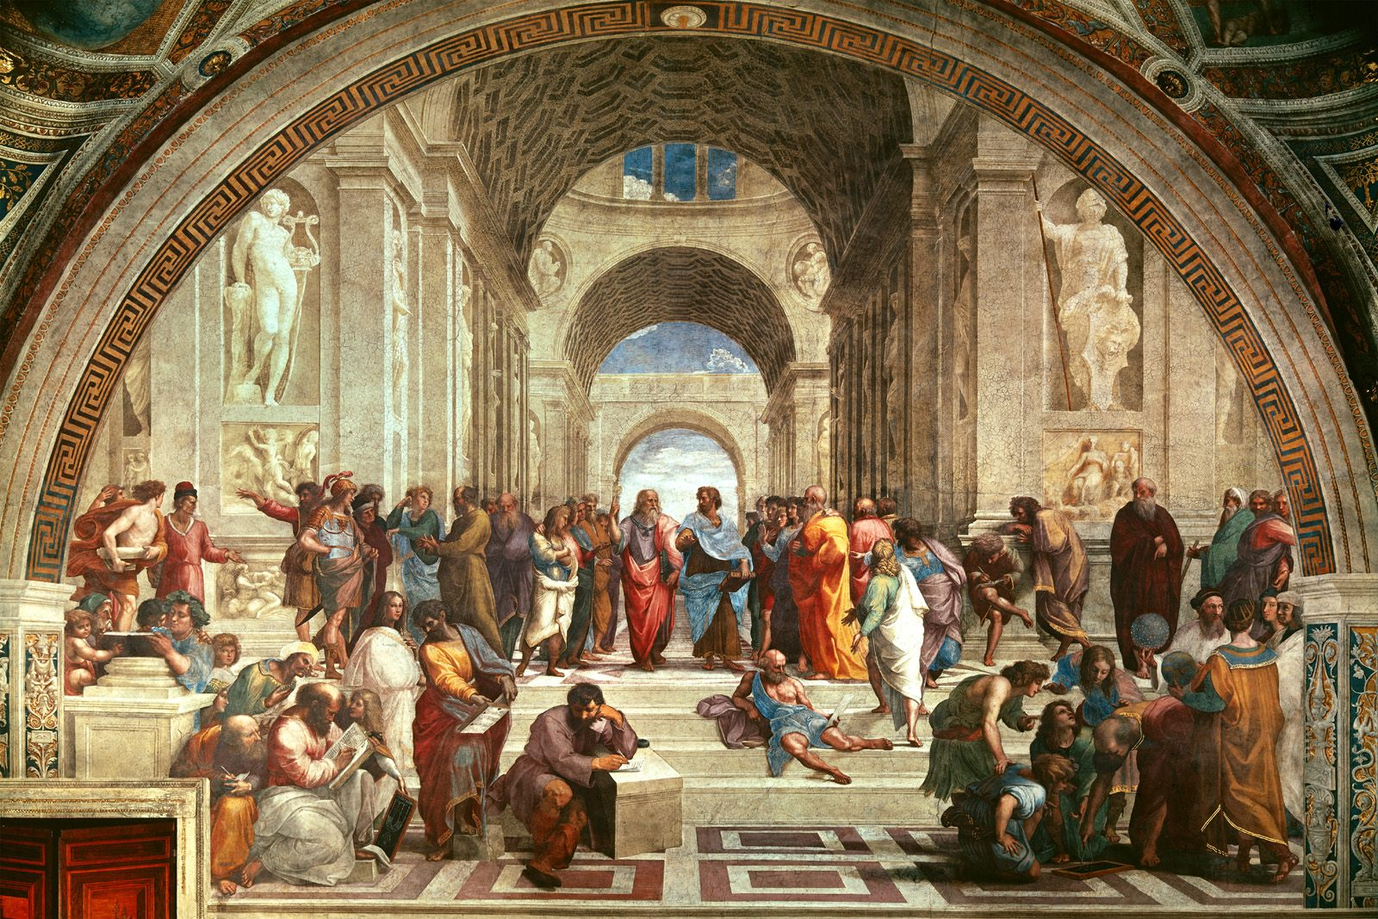
Meetkunde
SBIDZ Open Saldanha Tegnologie in die onderrig van Wiskunde Aanlyn kursus

Slide 2
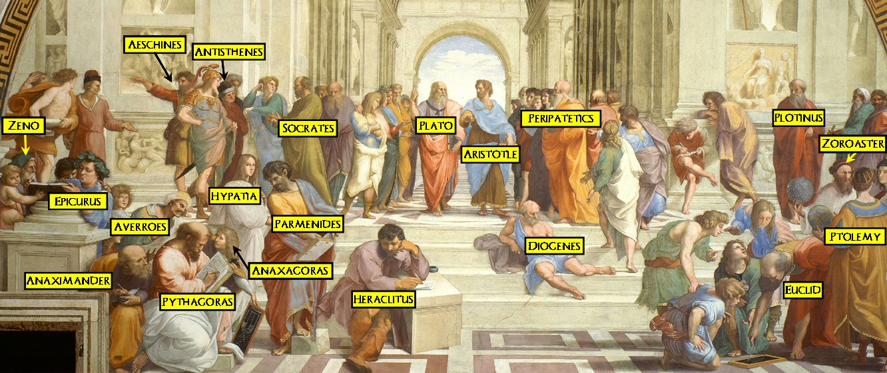

Slide 3
Session 1
16:00 – 16:15: Orientation
16:15 – 17:00: Part 1
17:00 – 17:30: Breakaway task

Slide 4
DAY / DATE | TIME | TOPIC | LECTURER
Week 1 Thursday 27 August 16:00 to 17:30 then some group/own work each week | Part 1: 90 minutes Facilitated on MSTeams | Session 1: Orientation to connect with phone as hotspot Context, orientation and pedagogical objectives: From objects to spatial relations Analysis of concepts and skills in the CAPS in relation to geometry and measurement. Horizon knowledge Tools determine reasoning Euclid’s approach Affordances and constraints of the tool for meaningful learning Advantages of using a dynamic dynamic tool Geometric habits of mind for the 21st century | E. Lampen A. Olivier
 | Part 2: Individual work with group interaction 90 minutes | Session 1: Olivier’s Theorem Introduction to Geometer’s Sketchpad Work through Olivier’s Theorem. Use GSP to investigate. Learn just in time what you need to do the investigation Refer to the GSP help guide Prepare a document with your explanation to present on TEAMS session in Week 2 Practice with a buddy to share screen | E. Lampen Students

Slide 5
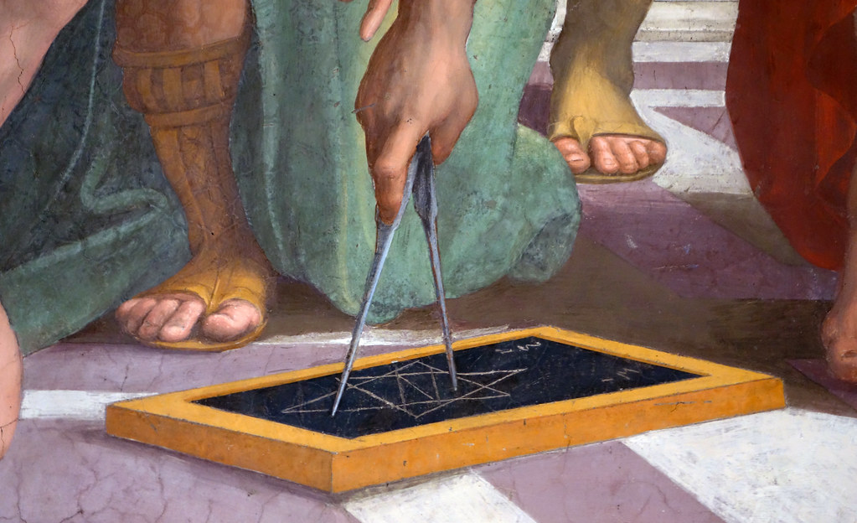
Om ‘n konstruksie te verstaan – ‘n proses van meetkundige denke.
Euklides se eerste probleem is: “Konstrueer ‘n gelyksydige driehoek.”
Wat maak dit ‘n probleem?
Die Grieke se apparaat:
Passer kon nie afstand behou nie
Implikasie: Absolute meting is van geen waarde in Meetkunde nie. Wel verhoudings: ewe lank; helfte so lank…

Slide 6
Meetkundige dinkgewoontes
Dink aan verskille tussen verwante gevalle as die gevolg van funksies wat verandering veroorsaak
Dink oor kontinue verandering en vra: wat bly dieselfde en wat verander
Dink oor afhanklikheid en onafhanklikheid (oorsaak en gevolg)
Vergelyk met ideale (of ekstreme)gevalle, hoe ver weg? Proporsionele denke
Meetkundiges is nie bang vir getalle nie, maar hulle meet nie
Meetkundiges maak figure as voorstellings en analiseer, klassifiseer die figure
Bewys – beskryf logiese verbande tussen uitsprake

Slide 7
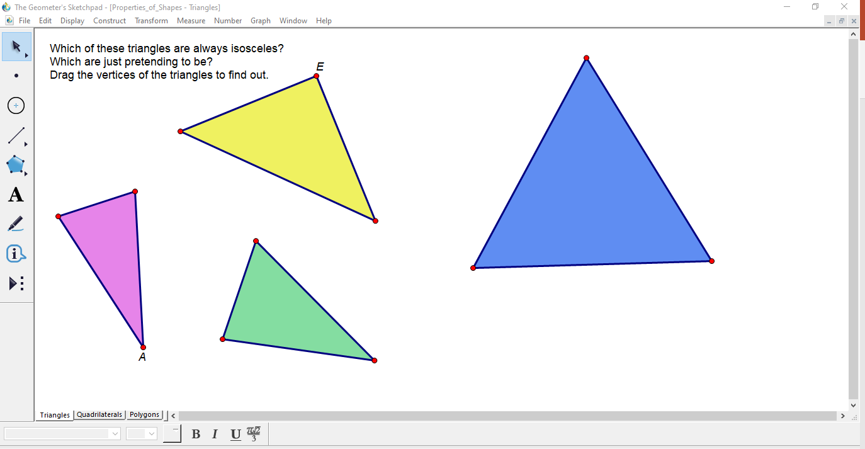
Dinkgewoontes en die rekenaartoepassings
Rondspeel om te sien wat verander en wat bly dieselfde
Ontwikkel begrip van oorsaak en gevolg
Eksperimenteer en maak voorlopige stellings
Demonstreer, struktureer en bewys
Gaan na: GSP, Help, Online Resource Centre, Sample sketches and tools, Properties of Shapes, Triangles. Maak oop en eksperimenteer. Verduidelik!
Notes:
Area of circle in terms of x
Distance DF, equilateral triangle

